Slide 1



PROBLEM STATEMENT-1 AI IN HEALTHCARE
Dr. FOODIE
(An Artificial Intelligence Based Dietician)
Submission by:-
TEAM: “Divide and Conquer”
SAGAR ANAND SUHANI KOHLI
DIVIK SHRIVASTAVA SHRESHTH SHARMA

Slide 2
PROBLEM STATEMENT
Dieting is the practice of eating food in a regularized and supervised fashion to decrease, maintain or increase body weight, or to prevent and treat diseases.
Therefore, there is a need of an online diet consultant which saves the cost and time of going to a real dietician.

Slide 3
IDEA
Our project acts as a diet consultant similar to a real dietician. The idea is to design an application which identifies the food we take and tells whether that food is healthy or not in accordance to the person’s current diet .

Slide 4
SOLUTION
Using Artificial Intelligence and Machine learning:
Input user details to predict diet plan
Food item identification from the photo of the meal
Diet data processing
User nutrition counseling

Slide 5
IMPLEMENTATION
First we used OpenCV to process image of the food eaten by user.
Then we use the YOLO(You Only Look Once) algorithm to identify objects within the given image using deep neutral net(readNet) which contains weights of various food items. After that once the object is matched in the given image, a boundary wall is created around it and its name is also labelled.
Further using the data of standard calories, we determine the total calories in that food item.

Slide 6
TECHNOLOGY USED
Python : Version 3.4
OpenCV : Version 3.4
numpy : Version 1.5
argparse : Version 1.4.0
XLRD : Version 1.2.0
YOLO

Slide 7
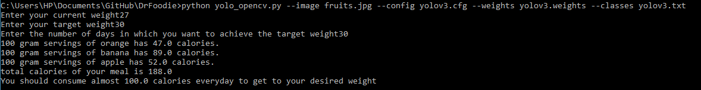
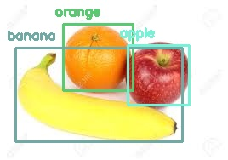
RESULTS

Slide 8
LIMITATIONS
One has to be sure about their details while entering fields like weight otherwise this application would give results that is not suitable for user if not sure about what they entered.
The quantity of food items is assumed to be of 100 gram servings and this application is aiming at giving the user an insight about calories being consumed as compared to his or her target.
The pic of the food must not also be blurred.

Slide 9
CONCLUSION
Thus we created a reliable system that calculates total calories of the meal a person is about to have in a hassle free manner with advice on modifying his diet to meet his calorie goals.
Dietitians can use this system to make sure what they recommend patients.
This system can be very well used in medical colleges for teaching and practicing purposes so that student can learn from it.
This system can also be utilized in gym particularly for calculating the customers' calories and diet plans.
Individual can also use this software especially for themselves in home.

Slide 10
FUTURE SCOPE
To make it a real time system in which a person can upload the pic of his meal and get the suitable recommendation.
To increase the number of dishes which are consumed around the world so as to make it user friendly at global scale.

